Slide 1
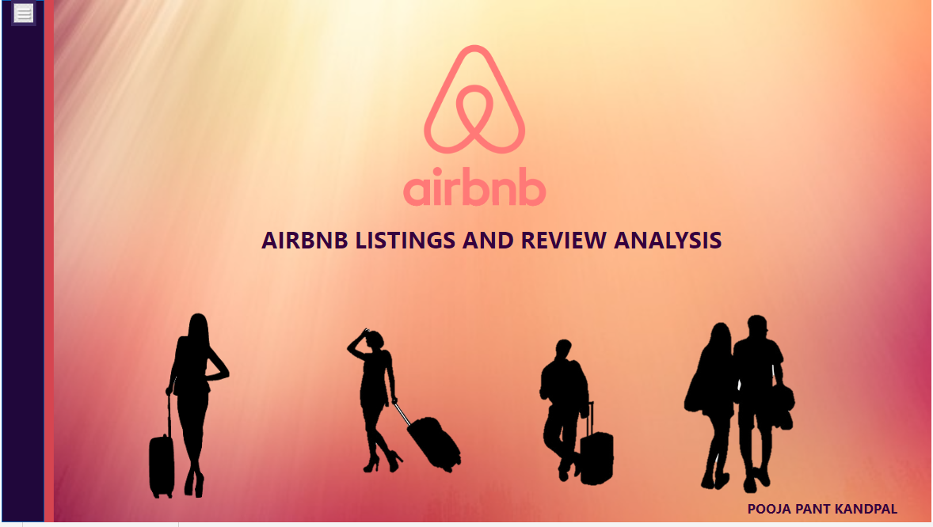

Slide 2
About the Company
Airbnb is a global online marketplace and hospitality service platform that enables people to list, discover, and book accommodations and experiences around the world. Founded in 2008 by Brian Chesky, Joe Gebbia, and Nathan Blecharczyk, Airbnb has transformed the traditional hospitality industry by allowing individuals to rent out their homes or properties to travelers.
The platform connects hosts (individuals offering accommodations) with guests (travelers seeking lodging) and offers a diverse range of property types, including apartments, houses, unique stays, and more. Airbnb has expanded beyond accommodations to include experiences and activities hosted by locals, providing travelers with unique and personalized adventures.

Slide 3
Objectives
Global Expansion:
Airbnb aimed to continue expanding its global presence, reaching new markets, and increasing the diversity of available accommodations and experiences worldwide.
Community Building:
Fostering a sense of community among hosts and guests has been a fundamental objective. Airbnb seeks to create a platform where individuals can connect with local cultures and build meaningful relationships.
Diversification of Offerings:
Beyond traditional accommodations, Airbnb has sought to diversify its offerings. This includes the introduction of unique stays, experiences, and other travel-related services to cater to a broader range of traveler preferences.
Enhanced User Experience:
Improving the user experience on both the host and guest sides of the platform has been a priority. This involves refining the booking process, enhancing search functionality, and incorporating user feedback into platform updates.

Slide 4
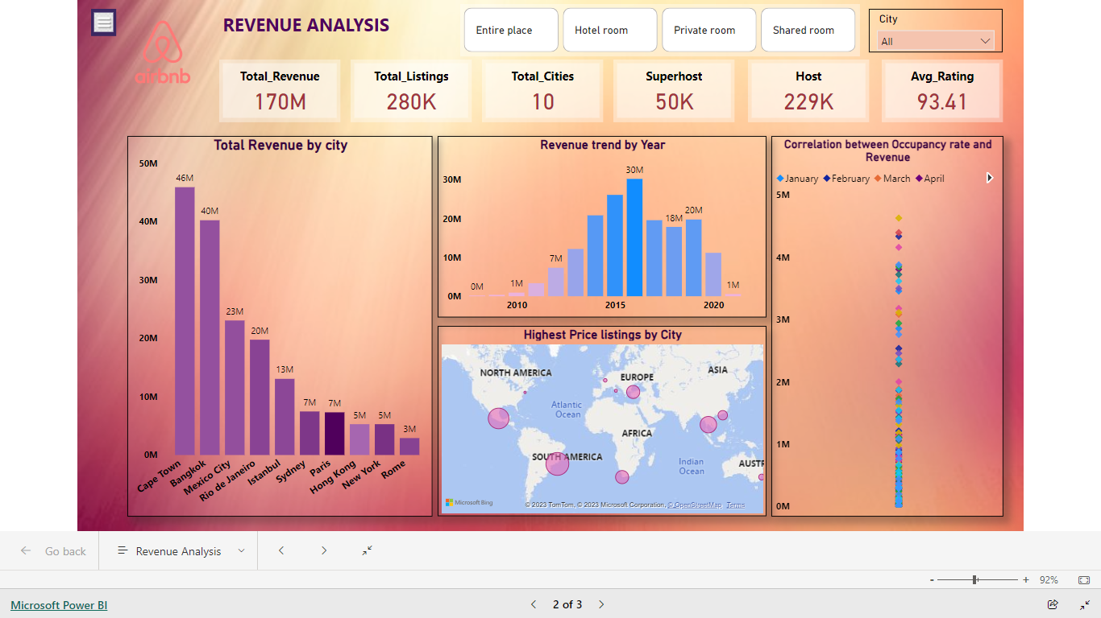
Key Performance Indicators
Airbnb boasts a substantial presence with 280,000 listings spanning 10 cities, demonstrating a robust and diverse global footprint.
2.The platform has achieved a commendable total revenue of $170 million, underscoring its economic significance in the hospitality and travel sector.
With a hosting community of 229,000 individuals, Airbnb has cultivated a vast network of hosts contributing to its dynamic ecosystem.
A noteworthy 50,000 hosts have earned the esteemed title of Superhost, reflecting a commitment to exceptional hospitality and guest experiences.
Airbnb's commitment to quality is reflected in its impressive average rating of 93.41, indicating consistently positive guest feedback and satisfaction.

Slide 5
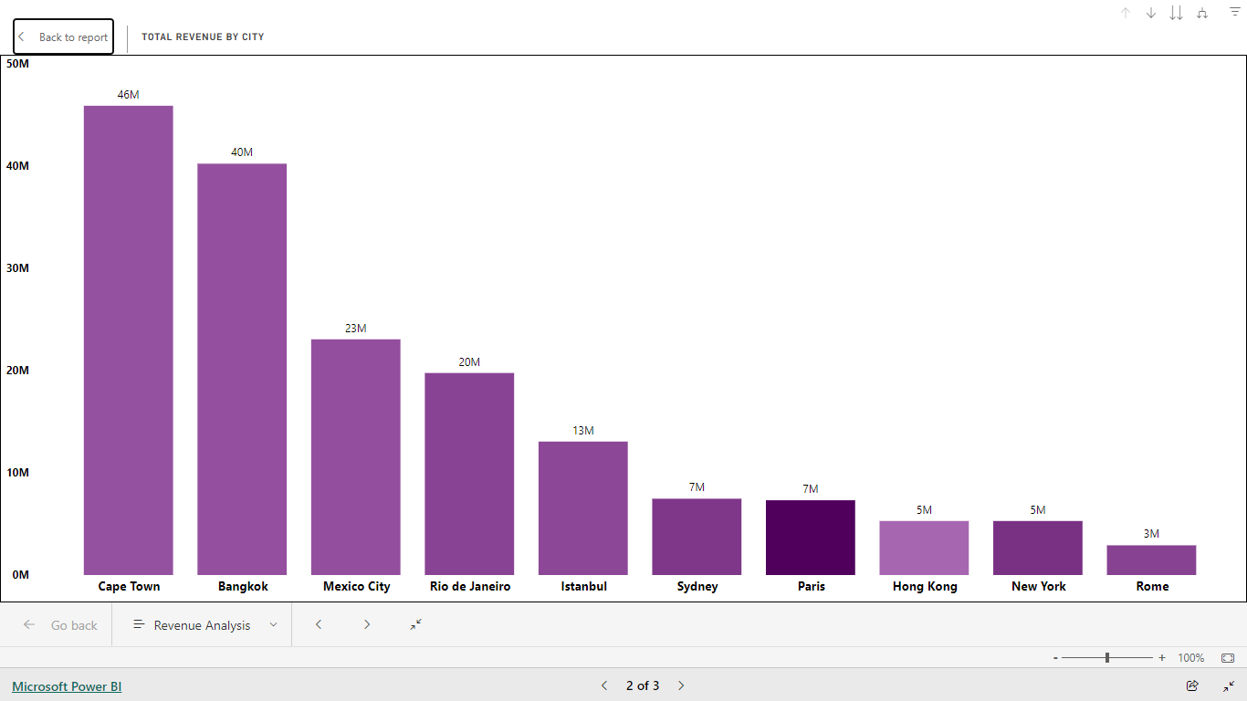
Which city made the maximum and the least revenue ? Cape Town made the maximum revenue of 46M whereas Rome made the least revenue of 3M.
Revenue Analysis

Slide 6
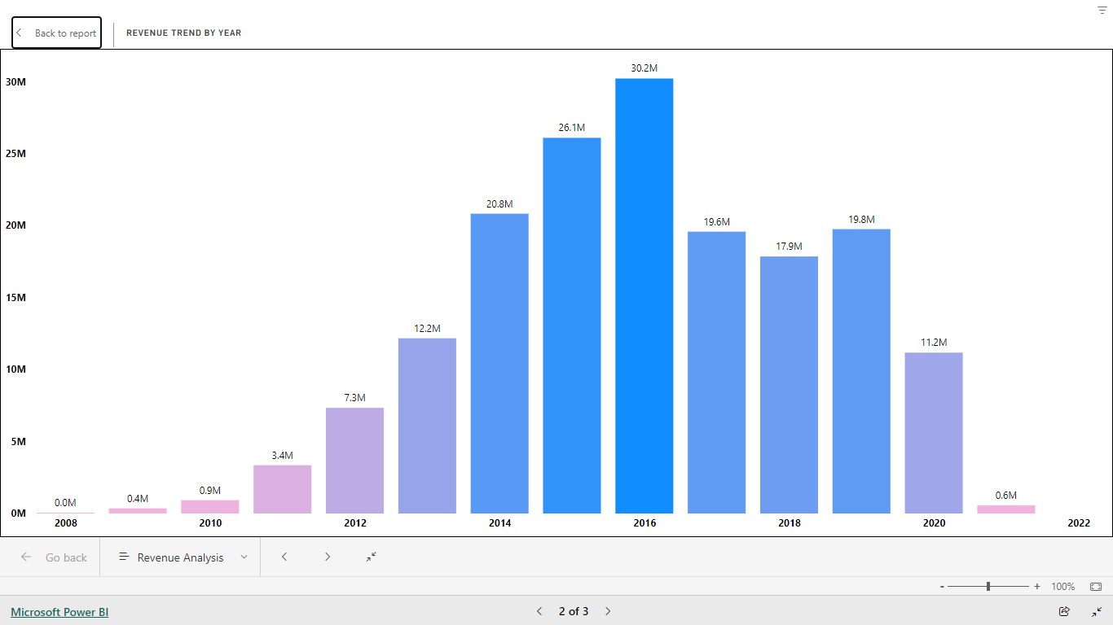
Revenue trend by Year The revenue trend illustrates a positive trajectory over the years, reaching its peak in 2015 at $30.2 million, showcasing consistent financial growth followed by 2014 at 26.1M

Slide 7
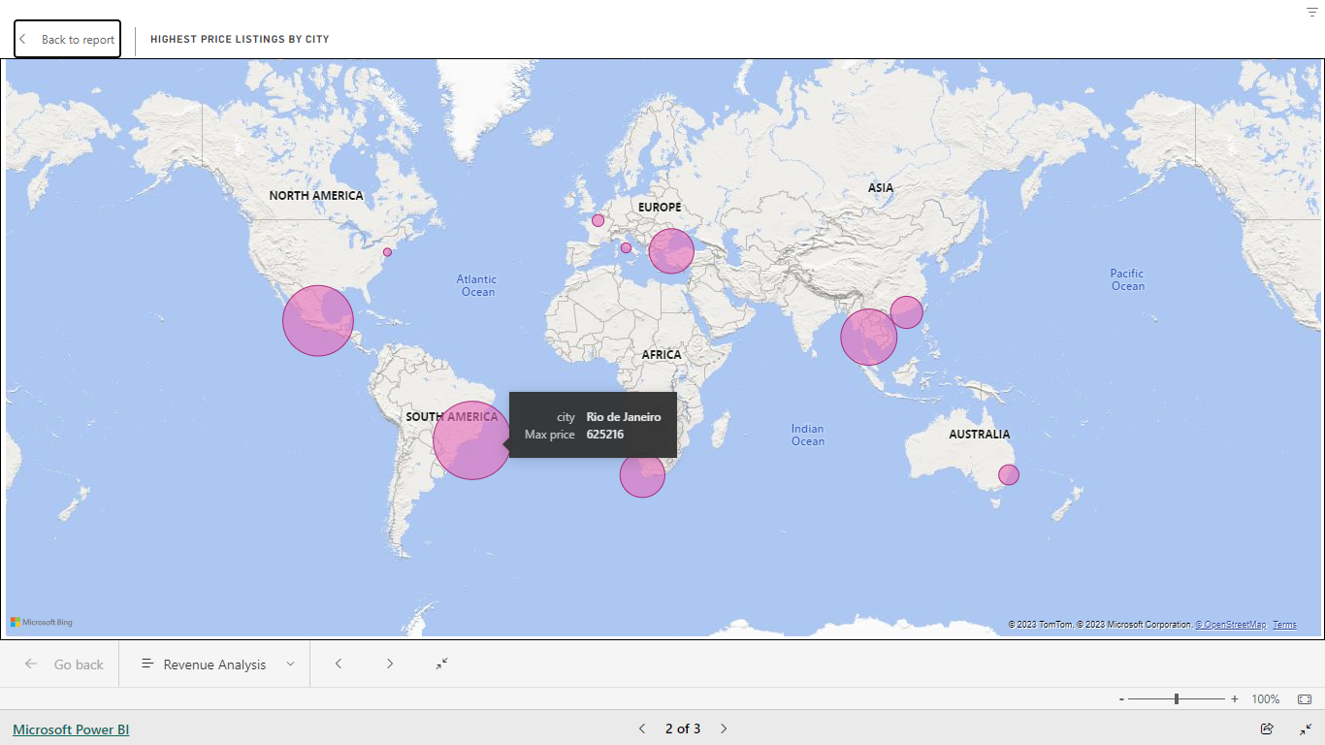
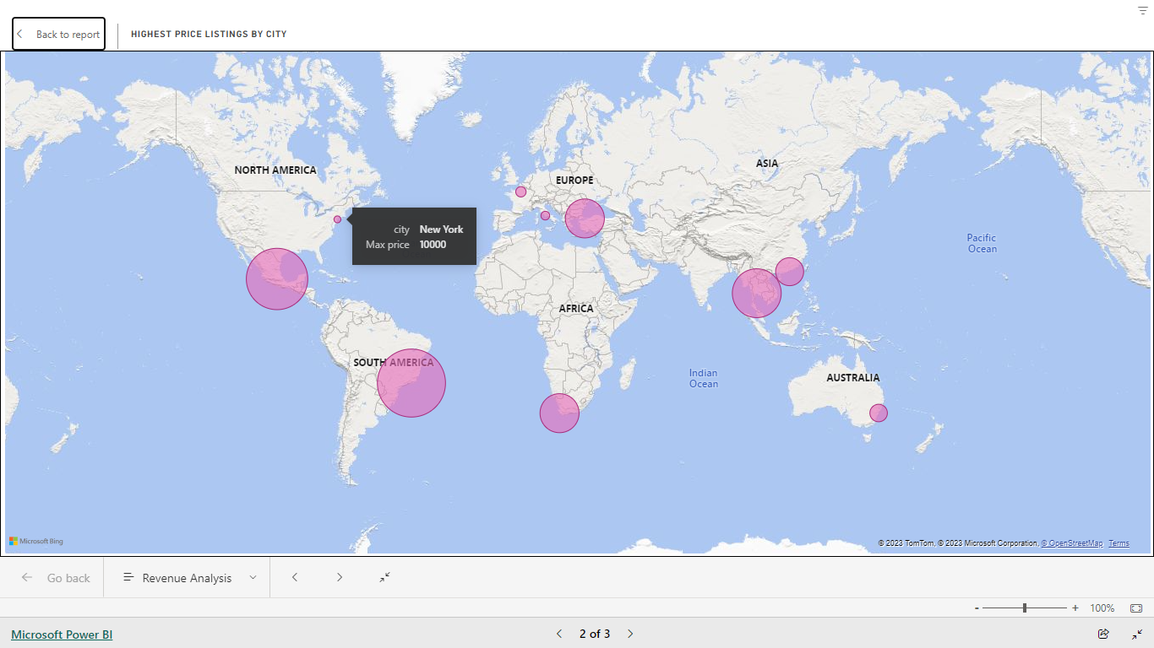
Highest and lowest priced listings located on the map? Rio de Janeiro has the highest priced listings whereas New York has the lowest price listings.

Slide 8
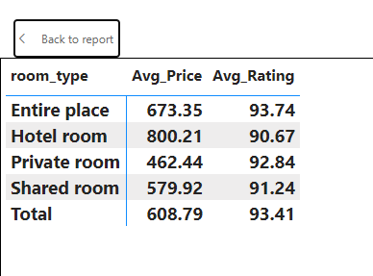
Which room_type is most and the least preferred by the customers? Entire place is preferred the most whereas Hotel rooms are the least preferred may be because of the high price rates.
Review Analysis

Slide 9
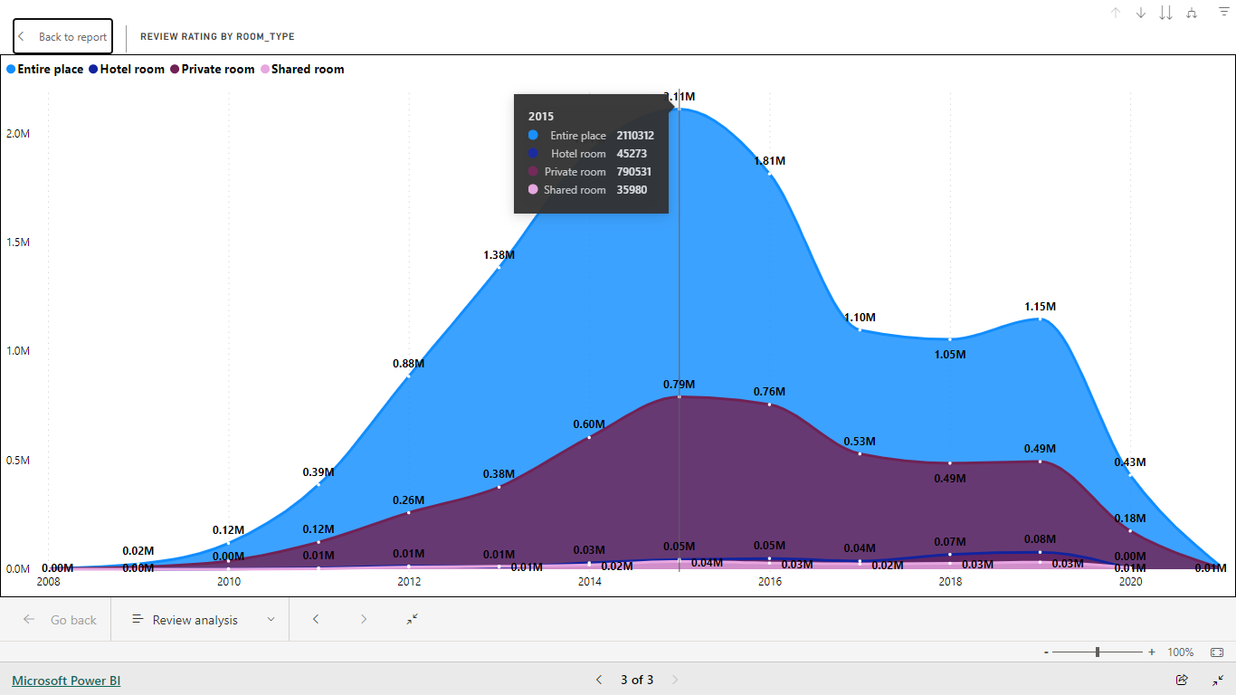
What are the yearly trends in review ratings for different room types? * The "Entire Place" category received the highest average review ratings in 2015, suggesting that guests who booked entire homes or apartments were particularly satisfied with their accommodations. * The "Shared Room" category received the least favorable average review ratings in 2015, indicating that guests who booked shared accommodations were less satisfied compared to those who booked entire places, hotel rooms, or private rooms.

Slide 10
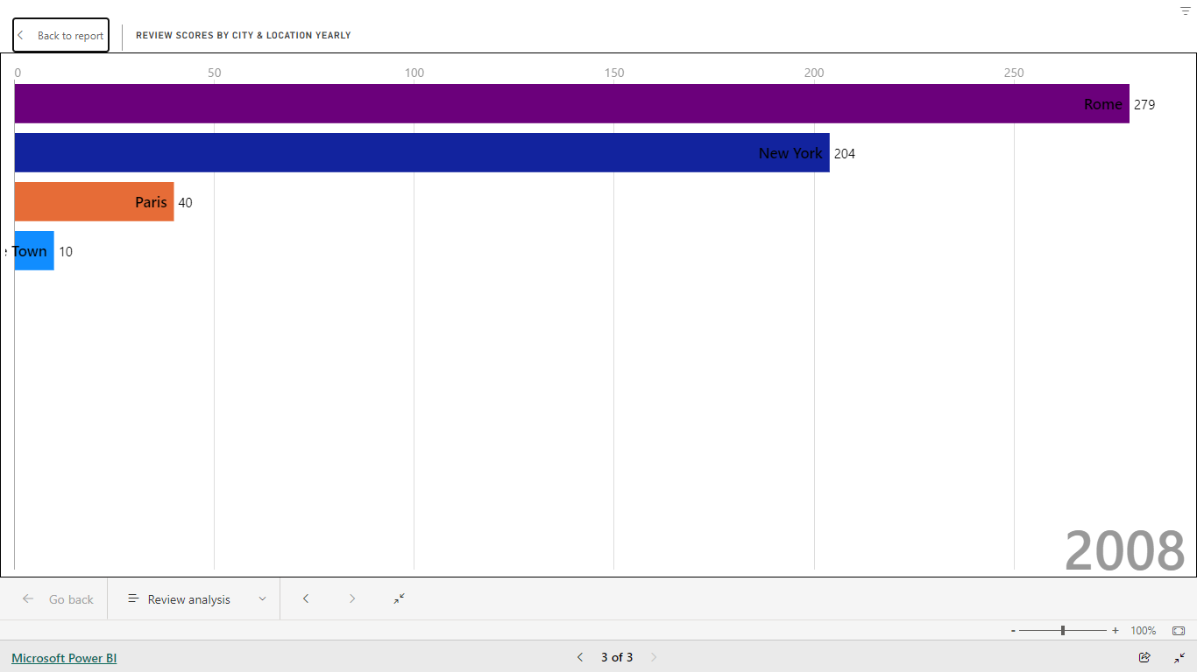
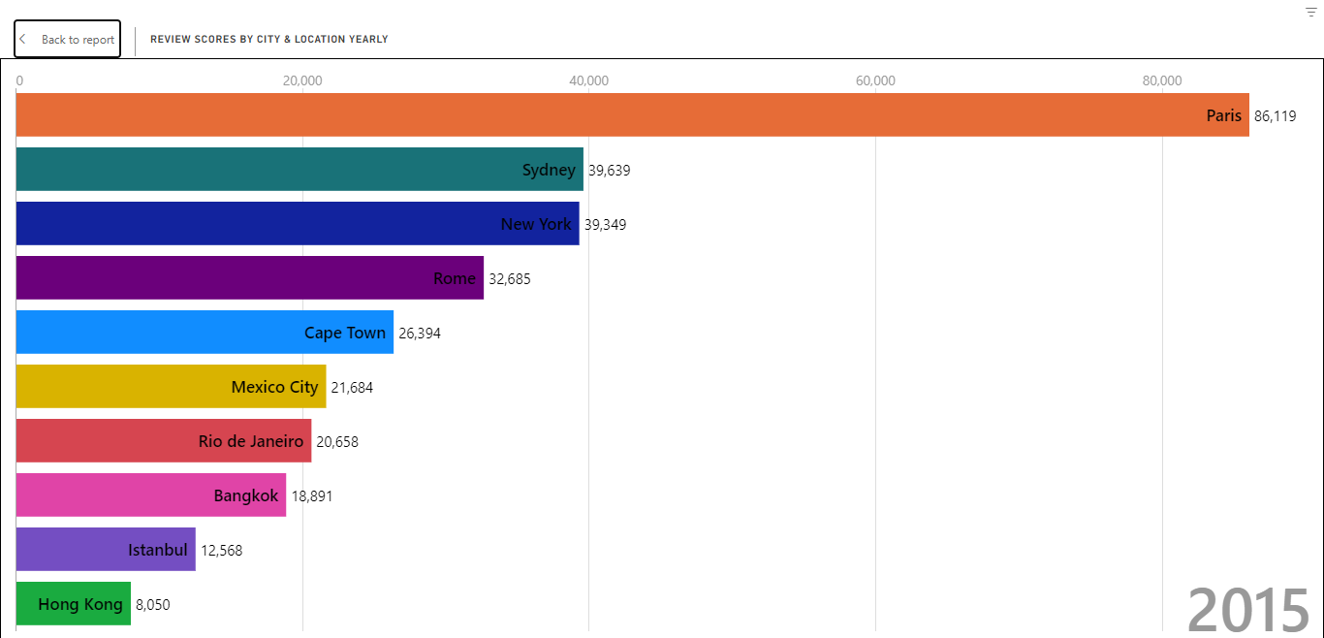
What is the yearly variation in review scores for each city represented in the dataset, and are there consistent patterns or fluctuations over time?
In 2008, top 4 cities in terms of locations by customers satisfaction includes- Rome, New York , Paris and Capetown
Similarly , In 2015 top 4 cities were- Paris, Sydney , New York , Rome

Slide 11
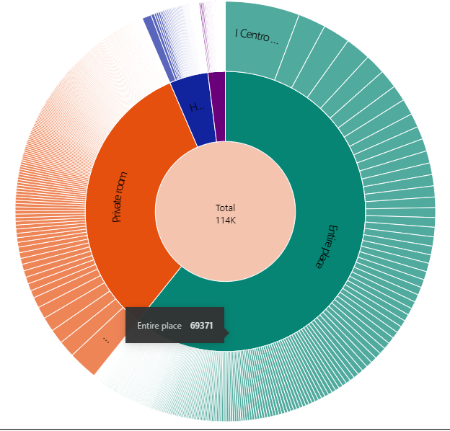
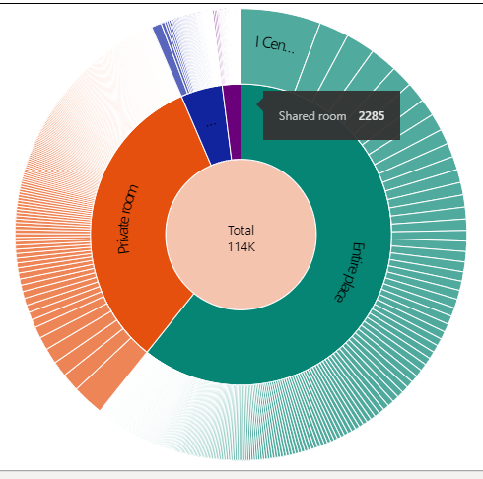
How is the distribution of total instant bookings across different room types, and which type is most frequently booked with instant booking? Out of 114K total instant bookings Entire place had maximum number of instant bookings(69371) whereas shared rooms had least instant bookings(2285)

Slide 12
Recommendations
Enhance Host Communication:
Encourage hosts to maintain prompt and effective communication with guests to improve review scores and overall satisfaction.
Diversify Property Offerings:
Explore opportunities to diversify property types, amenities, and experiences to cater to a broader range of guest preferences.
Geospatial Insights:
Leverage geospatial analysis to identify high-demand neighborhoods, allowing hosts to strategically position their properties for increased bookings.
Price Optimization:
Implement dynamic pricing strategies based on seasonality, local events, and market demand to maximize revenue potential.
Review Sentiment Analysis:
Utilize sentiment analysis on reviews to identify common positive and negative themes, allowing hosts to address specific areas for improvement.

Slide 13

Thank you

